Slide 1

Crisis Early-Warning System
WiDS @ AUB 2025 – Track 2: Healthcare Resilience & Early

Slide 2


Presentation Agenda
Overview of Topics in This Presentation
Problem and Objective: Addressing Bed Shortages
Data Sources: Open and Reproducible Data
Features and Modeling: Approach and Techniques
Results and Alert System: Insights and Actions
2

Slide 3
Hospital Bed Crisis
Addressing the Ongoing Shortage Challenge
Recurring Shortages
Predicting Crisis
Ethical Considerations
The hospital bed shortage is a recurring challenge that leads to patient refusals, delays, and diversions, impacting healthcare quality and accessibility for the community.
Our objective is to accurately predict crisis occurrences for each hospital service in week t+1, utilizing data available by the end of week t to inform decision-making.
We emphasize ethical use of open data and transparency, ensuring human-in-the-loop alerts and bias checks across departments to maintain trust and integrity in our predictions.
3

Slide 4

Data Sources Overview
Data Sources
Core Columns
The data comes from the Kaggle Hospital Beds Management dataset.
Important columns include beds, requests, admissions, refusals, and occupancy.
Grouping
Sorting
Data is grouped by service for effective analysis and modeling.
The dataset is sorted by week to maintain chronological integrity.
4

Slide 5
Data Splitting
Lagged Features
Categorical Encoding
Stratified Split
NA Removal
Lagged features were created using shift(1) for modeling.
Categorical variables were encoded to numeric codes for analysis.
NA rows were removed post-lagging to ensure data quality.
A 70/30 stratified split was applied for reproducible results.
5

Slide 6
Features and Modeling
Historical Features
Feature Selection
Model 1
Fourteen features include available beds and previous demand metrics.
Rationale emphasizes transparency while preventing data leakage issues.
RandomForestClassifier tuned for balanced class weights and depth.
Evaluation Metrics
Explainability Methods
Metrics report training accuracy and overfitting gap for insights.
Global feature importance and SHAP values enhance model transparency.
6

Slide 7

73.3%
Overall training accuracy of the crisis prediction model
The model achieved a training accuracy of 73.3%, indicating its moderate effectiveness in predicting hospital bed crises. Key performance metrics, including precision and recall, further highlight the system's reliability. This accuracy enables healthcare administrators to make informed decisions, ensuring timely responses to patient needs while minimizing the impact of bed shortages. Enhancing the model's interpretability through SHAP values allows stakeholders to understand and trust the predictions, ultimately improving patient care outcomes.
7

Slide 8
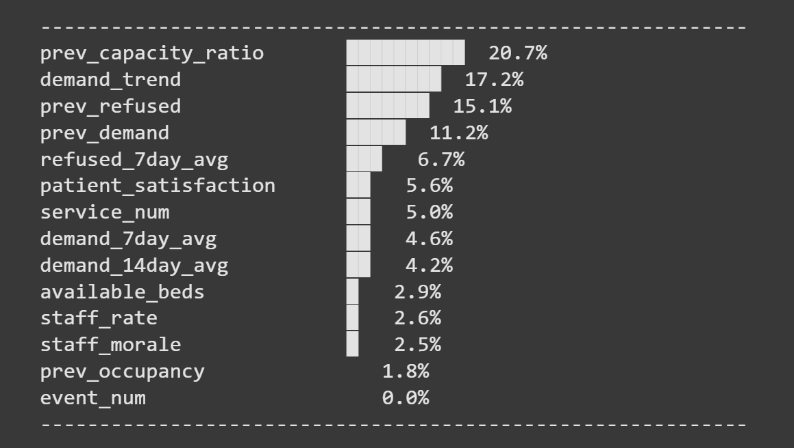
SHAP Insights
Understanding feature importance for crisis prediction models
Utilizing SHAP values helps identify the most impactful features, ensuring transparent decision-making in hospital bed crisis forecasting.
8

Slide 9
Our project supports the WIDS mission of advancing data-driven resilience, sustainability, and ethical AI using practical, open, and responsible innovation to strengthen healthcare systems.
1. Environmental Sustainability
Predictive resource planning prevents emergency overcapacity (temporary wards, staff transfers, energy spikes).
Reduces waste and carbon emissions from avoidable patient transfers and equipment overuse.
Promotes efficient utilization of existing hospital beds and staff — fewer idle or overflow units.
2. Operational & Social Resilience
Early alerts enable data-informed staffing and bed allocation, preventing burnout and improving patient care continuity.
Enhances system resilience under surges (flu season, pandemic spikes).
Empowers hospitals to do more with existing capacity, reducing inequality in patient access.
3. Ethical & Responsible AI
Uses open and transparent datasets (Kaggle, World Bank, UCI) , no private patient data.
Incorporates explainable AI (SHAP, feature importance) so medical leaders can trust and interpret alerts.
Maintains human-in-the-loop decision-making, AI supports but never replaces judgment.

Slide 10
Thank you!

